Slide 1
Collectively Solving the Opioid Epidemic
November 12, 2018
Eric Zierse
eric.zierse@collectivemedical.com
Presentation Maker

Slide 2
OUR MISSION
Eliminate Friction from Care Delivery
Through Real-Time Collaborative, Coordinated Care

Slide 3
The Collective Network

Slide 4
The Opioid Crisis
Over the last 20 years, the opioid crisis has grown from a major concern to a full-blown epidemic. Hundreds of thousands have died from opioids, a majority of which were prescribed by well-meaning physicians who lacked the patient information necessary to make the right call.
Opioid Overdose Deaths, 1999 – 2016
Fourfold increase in OD deaths from 1999 – 2008
64,000 OD deaths in 2016, 42,000 of those opioid deaths
(up from 52,000 total OD deaths in 2015)
200,000+ total opioid OD deaths between 1999 – 2016
Highest OD death rates exist in West Virginia, Maryland,
Maine, and Utah
50k
40k
30k
20k
10k
1999
source: CDC
2016

Slide 5
The Opioid Crisis – Washington and Collective Medical
Over the same period of time where the United Sates as a whole was seeing massive increases in opioid-related deaths, the state of Washington was beginning to see a significant decline. Among many efforts made in the state was the implementation of the Collective Platform across the state with the first hospital coming online in 2008.
Prescription Opioid-Involved Overdoses (Washington State)
10
8
6
4
2
0
deaths
hospitalization
rate per 100,000
2008
1995
source: www.ncbi.nlm.nih.gov
2013

Slide 6
Collaboration as a Radical Approach to the Opioid Epidemic
Collective Platform
Insights into both the patient’s history and plans for future care
Direct connections to state PDMPs, with automated querying and delivery of results
Collective has implemented a variety of features available nation-wide in addition to region-specific efforts designed to combat the unique needs of each state, all as a means to continue combatting the opioid epidemic. All of these efforts are about enabling and/or automating collaboration between points of care to ensure providers have the entire care continuum’s knowledge at their fingertips.
Regional Efforts and Prototypes
EMS Naloxone administration tracking/reporting
NAS identification and tracking/notification
Prescriber notification upon patient OD
Bridging patients with Suboxone administration in the ED to MAT facilities
42 CFR Part 2 consent tools to share SUD/OD information between care providers

Slide 7
Patient Insights

Slide 8
Insights – Collaborative Histories and Future Guidelines
Members of the patient’s care team, from all points of care, add Insights (categorized historical notes and ED-targeted care guidelines) to ensure a unified approach to patient interventions, specifically when addressing Substance Use Disorder (SUD) in the ED. Guidelines include information about unique patient complexities; details about whom to collaborate with; and recommendations on when to prescribe, including attached pain contracts when they exist.
How Does it Work?
All members of the care team—regardless of setting—are able to access and contribute to histories and guidelines in the Collective Platform at any time, before, during, or after encounters with the patient
Care team members add history bullets and care guidelines in advance of acute encounters in the ED, indicating the patient’s unique needs and factors that contribute to SUD/OUD
Notifications, which include care team details, Insights, PDMP histories, and historical encounter date, are delivered to the ED when the patient presents, directly within existing provide workflows
The Collective Platform tracks when Insights are entered/updated and reports on when patients may require changes to keep information current; also identifies and presents patients who may need Insights added
Care team members all approach interventions with
a unified course of action and an informed perspective

Slide 9
Insights – Collaborative Histories and Future Guidelines
Care History Example – Collaborative, Aggregate Background
Medical / Surgical History
Infection / Chronic History
Medication List (last updated 8/3/2017)
Ibuprofen, 800 mg TID PRN Migraine
Buprenorphine, 5 mg QD
Olanzapine, 5 mg QD
Diagnoses (last updated 8/3/2017) (EDIE instances only)
Opioid Use Disorder – Severe
On Buprenorphine in Office Based Treatment program at Virginia Life Center
Multiple past rehabilitation in and out patient
Alcohol Abuse
Tobacco Abuse
Schizophrenia
Past treatment with Quetiapine, Haldol
Currently prescribed Olanzapine; patient endorses non-adherence
Recommended treatment of Valproic acid adjunct with Olanzapine
Former treatment with Universal Mental Health Services (until 2/6/2015)
Pregnancy, Subsequent
G3P2
Ob/Gyn: Dr. James Edward Jones, Phone (276) 228-0200
Carpal Tunnel, recurrent
Surgery evaluation w Dr. Raghavan 5/7/2017, patient No Show
Migraine, recurrent
Treatment currently limited to Ibuprofen; patient endorses Sumatriptan allergy, undocumented.
Chronic Back Pain
Multiple negative CTs, last documented at IAH 12/2016, no known trauma
New Diagnosis, Chronic Back Pain
Behavioral History
New Diagnosis, Schizophrenia
Social History
Housing/Food
Homeless
Last extended stay at St. Anthony’s (May 2017), removed for suspicion of drug use
Chronic food insecurity
Seeks secondary gains such as money, food and shelter
Family/Social Network
2 Children in Foster care (contact Virginia Department of Social Services (804) 726-7000, Main Agency); patient has restricted access.
Sister has been past point of contact, Anne Taggarts, cell (804) 775 2756.
Transportation
Patient lost driver’s license in 2016
Given municipal bus pass April 2017
Demo Patient: Sally Croxton

Slide 10
Insights – Collaborative Histories and Future Guidelines
Care Guidelines Examples – Multiple Facilities, Same Patient
Virginia Family Clinic
Care Recommendation:
Patient is Pregnant, expected due date 2018-12-09.
Patient has a Substance Use Disorder, Opioid, and is currently under treatment with Buprenorphine treatment with Virginia Life Center; has exhibited past drug-seeking behavior.
Patient is under psychiatric care, with a diagnosis of Schizophrenia and anxiety. Patient is at risk for self-harm related to feelings of helplessness, loneliness, or hopelessness secondary to psychiatric disorder. Recommend the following treatment cascade:
Medications: Valproic Acid 250 mg PO then Olanzapine, 10 mg IM
Other Information:
1. Patient has LAMA in the past to see children; two children are currently in foster care.
2. Homeless; was removed from St. Mary’s Shelter d/t concern for opioid abuse. Application pending at Housing Works as 8/12/17.
3. Patient is known to be physically aggressive and combative.
Patient is under care at the Mount Virginia Behavioral Health for Psychiatry and Case Management, (276) 625-3300 and Fax is (276) 625-3311.
Innova Regional Hospital
Pain Management:
Patient was on office-based Buprenorphine treatment; no recent visits. Patient should not receive opioids as part of care; recommend NSAIDs and supportive therapy for complaints of pain.
Pain contract available in system.
Other Information:
1. Patient has LAMA in the past to see children; two children are currently in foster care.
2. The patient has a history of manic behavior, illicit drug abuse, multiple suicide attempts, and self-harm.
3. Homeless; was removed from St. Mary’s Shelter d/t concern for opioid abuse. Application pending at Housing Works

Slide 11
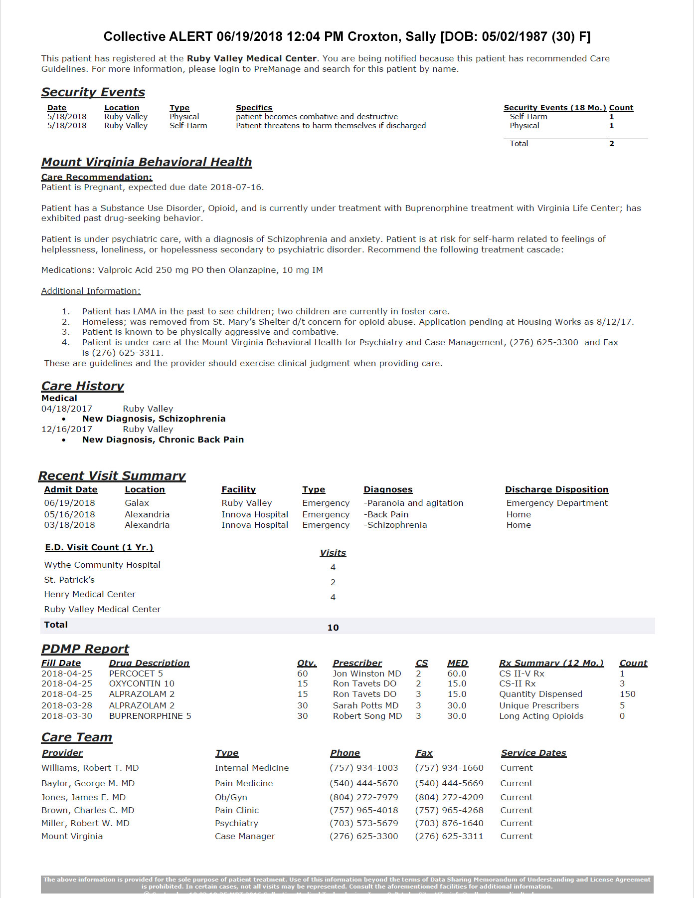

Insights – Collaborative Histories and Future Guidelines
Insights (both histories and guidelines) are automatically delivered as part of Notifications to all points of care, specifically the ED.
Strictly Confidential – © 2018 Collective Medical

Slide 12
PDMP and Collective EDie

Slide 13
PDMP with Collective EDie is More Effective Than the PDMP Alone
Collective and a state’s clinical consensus group work in tandem with the state to legislate access to the PDMP. Collective then checks every ED encounter against the PDMP, notifying treating physicians in the case of a significant prescription history.
How Does it Work?
Patient presents in the ED
Demographic information (i.e., name, date of birth, Social Security Number, etc.) and chief complaint are entered into the hospital’s EMR
Encounter and patient information are immediately forwarded to Collective and aggregated with existing patient information
State PDMP is contacted by Collective, historical prescription information is retrieved
PDMP information is examined according to criteria established by treating facility, and a Notification is delivered with details; Notification appears on ED tracking board
Physicians are made aware of a patient’s prescription history prior to engaging with the patient

Slide 14
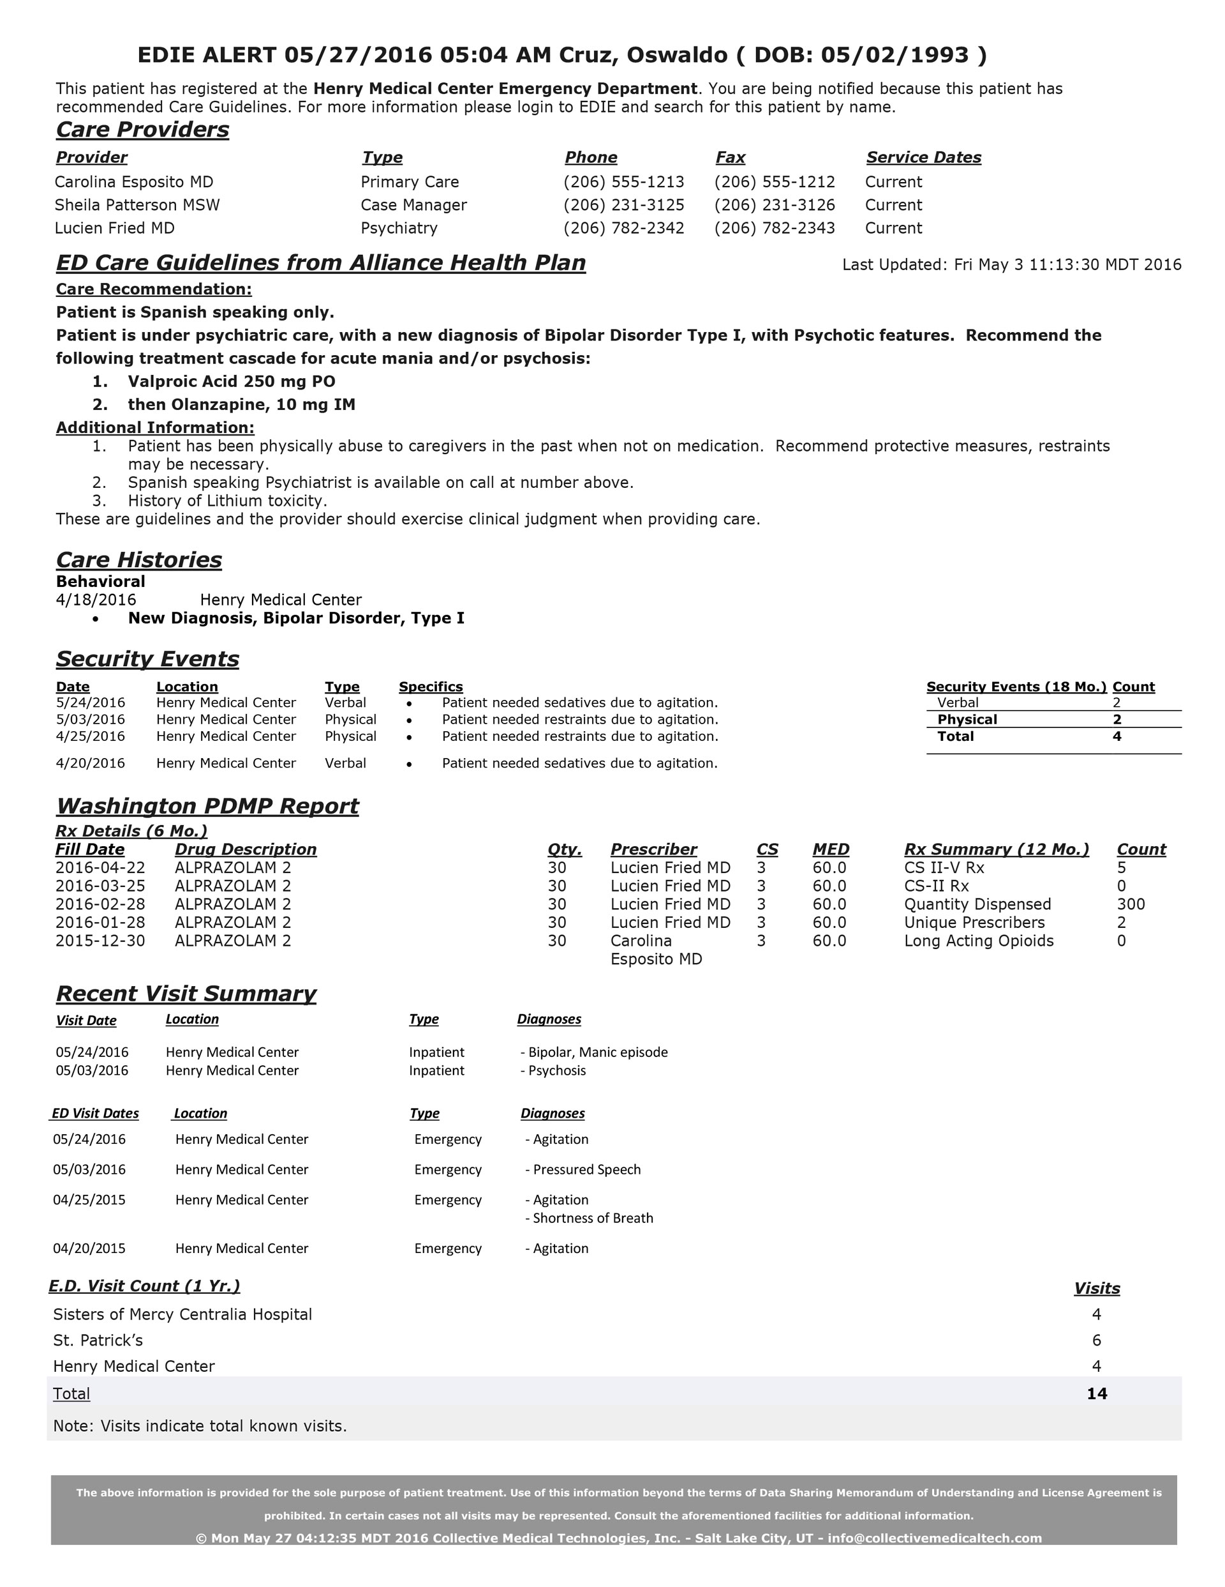




PDMP with Collective EDie is More Effective Than the PDMP Alone
Collective queries state PDMP for medication history and prescribers
PDMP information is compared
against on-file standard criteria
ADT Message
Hospital EMR automatically sends information about the encounter to Collective
Patient presents in a hospital’s emergency department
EDie Notification is delivered to ED staff within moments of patient registration
PDMP platform

Slide 15
PDMP with Collective EDie is More Effective Than the PDMP Alone
Automatic query and analyzing of PDMP data eliminates expectation of ED Provider to
identify prescription-related risk or launch external source for every patient
No separate portal launches, log-ins, patient queries, or expiring credentials
Real-time analytics and alerts can be configured using any PDMP data element:
  More than (X) prescribers within 12 months
  More than (X) controlled substance II-V prescriptions within 12 months
  More than (X) controlled substance II-V prescriptions within last 40 days
  Any prescription for methadone, suboxone, fentanyl transdermal, LA morphine, or LA oxycodone within last (X) mo
  Any overlapping prescriptions for narcotics (controlled substance II-V) and benzodiazepines within last (X) mo

Slide 16
PDMP with Collective EDie is More Effective Than the PDMP Alone
Strictly Confidential – © 2018 Collective Medical

Slide 17
Regional Efforts, Early Designs, and Prototypes

Slide 18
Early Designs, Prototypes, and Tests
The “Fine Print”
These projects span across multiple states and are in various stages, ranging from early design to pilot stage to fully implemented. Final outcomes have not been evaluated and are not guaranteed. Most of them are geographically dependent and were generated by local interest and available resources.

Slide 19
Collective is Currently Undertaking Five Prototype Opioid Reduction Efforts
Narcan / Naloxone Administration Tracking and Notification
Identification of Infants with NAS and Notification for Treating Physicians
Automated Letters to Prescribers When Patients Experience Overdose Events
Utilization of the Emergency Department as a Bridge to Rehabilitation
Consent to Share Under 42 CFR Part 2 for Suboxone as Medication-Assisted Treatment

Slide 20
Notifications for Narcan / Naloxone Administration

Slide 21
Notifications for Narcan / Naloxone Administration
Collective Medical, in tandem with the West Virginia Hospital Association, is piloting a program to leverage EMS data surrounding Narcan / naloxone administration.
How Does It Work?
Collective is connected to the Office of Emergency Medical Services’s (OEMS) state repository, into which all EMS encounters are recorded
The OEMS vendor provides Collective with files containing all EMS events in which Narcan / naloxone was administered
Collective associates these encounters with the appropriate patient with a chief complaint of “Naloxone Administered”
Criteria are established at all on-network hospitals in the state to deliver an automated notification if a patient presenting in the emergency department has one of these naloxone events within the past 12 months
Providers are able to engage with full knowledge of the patient’s history

Slide 22
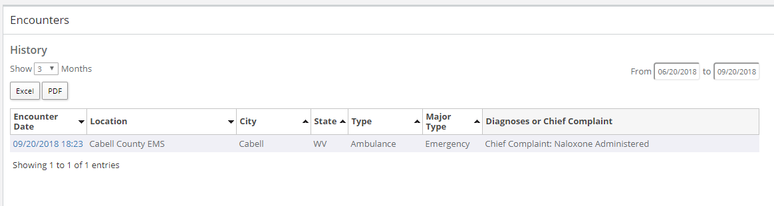
Notifications for Narcan / Naloxone Administration
The patient’s naloxone administration event is recorded in the Collective Platform
Criteria Established In-Platform for Notifications
The patient has had 1 encounter(s) in 12 Month(s) of specified visit type (none selected/all) or specified major type (none selected) with the following diagnosis phrase: “Naloxone Administered”
Simplified: Any Encounter within in the Past 12 Months with Diagnosis Containing “Naloxone Administered”
Criteria are established for notification delivery at future facilities

Slide 23
Neo-Natal Abstinence Syndrome:
Identification and Notification

Slide 24
Neo-Natal Abstinence Syndrome Identification and Notification
NAS Post-Discharge Concerns
Withdrawal at home is can be dangerous for the baby—dehydration from poor feeding, vomiting, or diarrhea can occur in just a few hours, and neurologic irritability can result in seizures
Infants with NAS are twice as likely as uncomplicated term infants to be readmitted to the hospital within 30 days of discharge
Families who seek medical attention for the baby after discharge often fail to disclose a history of substance use during pregnancy, and symptoms may not be recognized as NAS
Caregivers seeking medical attention post-discharge often don’t return to the original hospital
Reported cases validate the recommendation to observe these infants in the hospital for 4 – 7 days, even if there are no symptoms of NAS
Parents of infants with NAS often use their child’s medications instead of administering them

Slide 25


Incidence and costs of neo-natal abstinence syndrome are rising
Incidence of NAS per 1000 live births
NAS resulted in approximately
$2 billion
in excess costs among Medicaid financed deliveries
14
12
10
8
6
4
2
babies
covered by
Medicaid
Every 15
minutes
a baby is born
with NAS
all babies
in the U.S.
2004
2014
Infants with Medicaid are disproportionately affected
Prevention and treatment of substance use disorders are vital for women
before, during, and after pregnancy
Infants with NAS
covered by
Medicaid
Are more likely to
Hospital Costs for NAS
be transferred to another
hospital for care
Hospital costs for
NAS have grown
more than
6x since
2004
500
400
300
200
100
have longer lengths of
hospital stays
$ in
millions
Moms need resources and compassionate care
2004
2014
Source: Winkelman, T.N., Villapiano, N., Kozhimannil, K.B., Davis, M.M., Patric, S.W.,
Incidence & Costs of Neonatal Abstinence Syndrome among Infants with Medicaid: 2004 – 2014, Pediatrics published online: March 23, 2018

Slide 26

Neo-Natal Abstinence Syndrome Identification and Notification
Cabell Huntington Hospital (>500 babies delivered annually with exposure to controlled substances, roughly 400 requiring MAT) and Collective are working in tandem to push information to emergency departments within the state.
Early Objectives
Shared histories and recommendations
Improved hand-off to pediatricians
Bi-directional communication for case management
Improved follow-up compliance
Developmental tracking beyond infancy
Support network and protection plan coordination
Postpartum support

Slide 27
Washington Overdose Letter Automation

Slide 28
Washington Overdose Letter Automation
The Washington State Medical Association (WSMA), the Washington State Hospital Association (WSHA), the Washington State Health Care Authority, and the Washington State Department of Health are utilizing the Collective Platform as a means to automatically deliver overdose notification letters to pilot doctors when patients for whom they’ve prescribed opiates experience an overdose event.
How Does it Work?
Providers choosing to test this project have opted in with WSHA, provided contact information
This list of doctors and their contact information is shared with Collective
When patients are admitted to any ED in Washington with an opioid overdose diagnosis, the EMR automatically, instantly notifies Collective
Collective identifies opiate-prescribing physicians for the patient in the state PDMP
Letters written by the co-op are automatically delivered to participating physician(s)
Physicians are now aware of their role in overdose events and can self-identify improvements

Slide 29
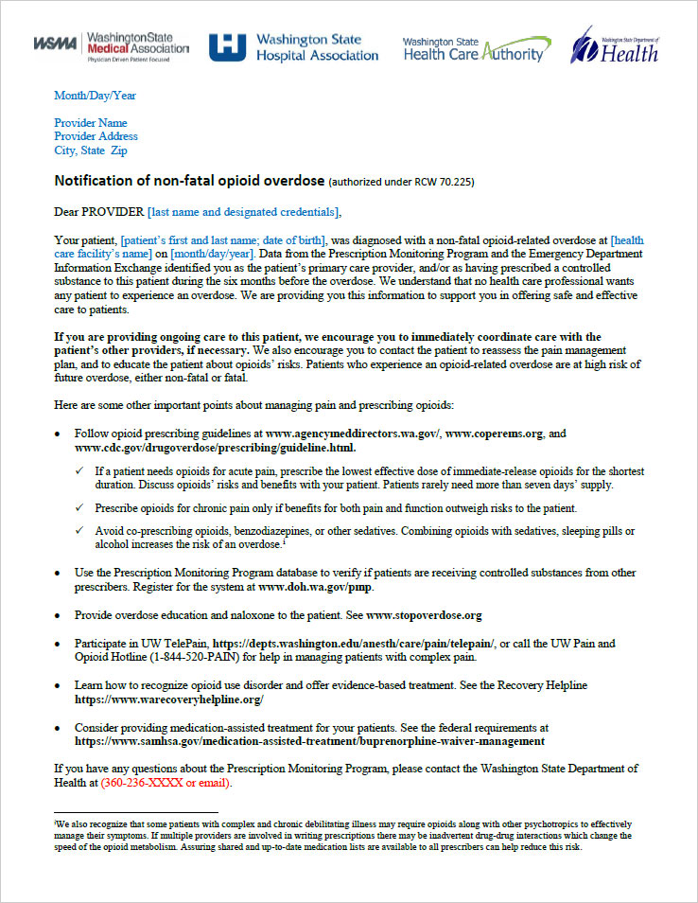
Washington Overdose Letter Automation
Information about the patient’s all-network history is sent to
treating facility
(Collective as normal)
pilot physician
email / DEA import
Collective queries state PDMP for medication history and prescribers
PDMP information is compared
with on-file list of pilot prescribers
Patient arrives at hospital with an overdose diagnosis and disposition
Letter(s) are delivered via email or fax to identified physician(s) who are part of pilot
State PDMP

Slide 30
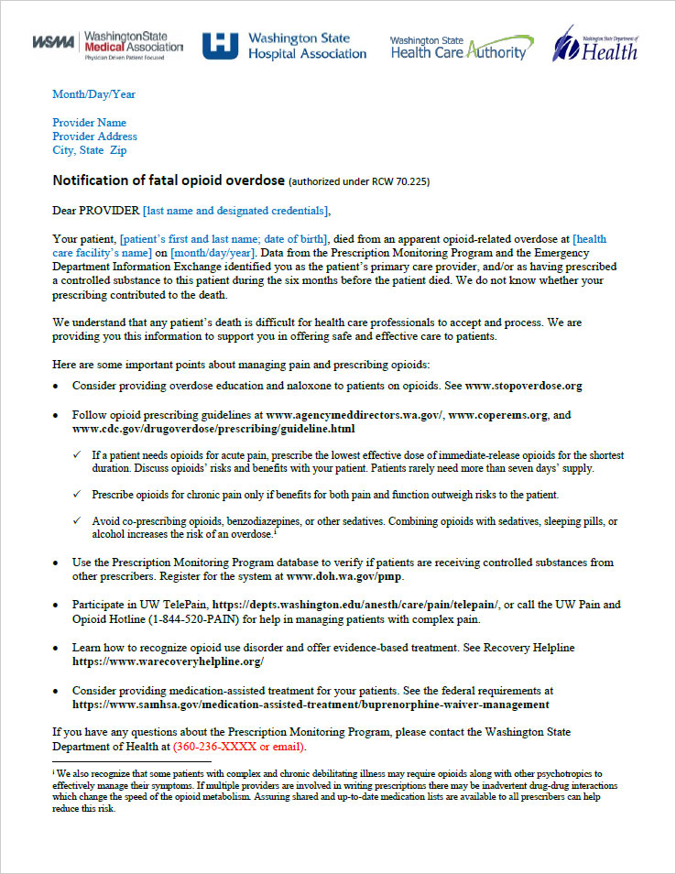
Washington Overdose Letter Automation
Sample Letter: non-fatal opioid overdose
Sample Letter: fatal opioid overdose

Slide 31
ED Bridge
Automated ED-to-MAT Transitions

Slide 32
ED Bridge
ED Bridge seeks to utilize the period of lucidity during buprenorphine treatment as an opportunity to refer patients to medication-assisted treatment (MAT) providers in dedicated treatment settings or federally qualified health centers. Collective seeks to serve as a transmission means between the referring ED and the referred treatment clinic who can then proactively contact the patient
How Does It Work?
ED physician administers buprenorphine / Suboxone treatment to patient in withdrawal
Patient grants consent to communicate SUD information to referred treatment clinic
Collective receives orders from hospital EMR
Notification is automatically delivered to referred treatment clinic indicating when buprenorphine / Suboxone treatment occurred
Referred facility follows up to arrange additional treatment
Patient bridges directly from the ED to a treatment facility with a dramatically higher rate of success

Slide 33

ED Bridge
This E.R. Treats Opioid Addiction on Demand. That’s Very Rare.
https://www.nytimes.com/2018/08/18/health/opioid-addiction-treatment.html
August 18, 2018
“With a single E.R. visit we can provide 24 to 48 hours of withdrawal suppression, as well as suppression of cravings,” said Dr. Andrew Herring, an emergency medicine specialist at Highland who runs the buprenorphine program. “It can be this revelatory moment for people — even in the depth of crisis, in the middle of the night. It shows them there’s a pathway back to feeling normal.”
It usually takes many more steps to get someone started on addiction medicine — if they can find it at all, or have the wherewithal to try. Locating a doctor who prescribes buprenorphine and takes insurance can be impossible in large swaths of the country, and the wait for an initial appointment can stretch for weeks, during which people can easily relapse and overdose.
A 2015 study out of Yale-New Haven Hospital found that addicted patients who were given buprenorphine in the emergency room were twice as likely to be in treatment a month later as those who were simply handed an informational pamphlet with phone numbers.

Slide 34

ED Bridge vs. Standard Appoach
Standard Approach
Patient is prescribed medication to treat symptoms, might be given numbers to call about treatment
Patient is expected to contact MAT treatment facility on their own…
…more likely, patient returns to the ED when withdrawal symptoms return
Patient arrives at hospital with withdrawal symptoms
ED Bridge Approach
Buprenorphine administered, physician enters MAT referral into EMR
Collective receives referral via HL7 transmission
Patient is contacted proactively, treatment commences
Patient arrives at hospital with withdrawal symptoms
Patient information, including buprenorphine administration time/date, is delivered to MAT facility

Slide 35
ED Bridge Workflow
Buprenorphine administered, physician enters MAT referral into EMR
Collective receives referral via HL7 transmission
Patient is contacted proactively
by MAT facility
Patient arrives at hospital with withdrawal symptoms
Patient information, including buprenorphine administration time/date, is delivered to MAT facility
Three Major Possible Outcomes
1
2
3
Patient successfully enters MAT
at referred facility
AND
Patient grants consent
under 42 CFR Part 2
Patient successfully enters MAT
at referred facility
AND
Patient DOES NOT grant consent
under 42 CFR Part 2
Patient either refuses treatment
at MAT facility or
no-shows for treatment
Conversion is Captured by Collective

Slide 36
Patient successfully enters MAT
at referred facility
AND
Patient grants consent
under 42 CFR Part 2
Notification is sent to both the ED (if possible) and the MAT facility the patient has been attending, notifying each of the other’s involvement and facilitating coordination
1
1 ONLY
Collective receives encounter
via normal ADT process
Patient successfully enters MAT
at referred facility
AND
Patient DOES NOT grant consent
under 42 CFR Part 2
ADT
2
Patient arrives at hospital again with withdrawal symptoms
Patient is redirected to MAT treating facility after ED re-administers buprenorphine
Patient either refuses treatment
at MAT facility or
no-shows for treatment
Buprenorphine administered, physician enters MAT referral into EMR
Collective receives referral via HL7 transmission
Patient is contacted proactively
by MAT facility
3
Patient arrives at hospital again with withdrawal symptoms
Patient information, including buprenorphine administration time/date, is delivered to MAT facility

Slide 37
1
2
3
Patient successfully enters MAT
at referred facility
AND
Patient grants consent
under 42 CFR Part 2
Patient successfully enters MAT
at referred facility
AND
Patient DOES NOT grant consent
under 42 CFR Part 2
Patient either refuses treatment
at MAT facility or
no-shows for treatment
Patient attends their first appointment
Collective receives encounter information indicating the appointment is kept (i.e., successful conversion)
MAT facility attempts to gain consent under 42 CFR Part 2
Patient agrees to grant consent
Collective captures consent in the platform for the facility
Treating provider reviews Collective buprenorphine administration information from the referring ED encounter
- - - - - - - - - -
During any subsequent encounters in the ED, notification is immediately delivered to BOTH the treating MAT facility, notifying them of the encounter, and to the ED, notifying them of the MAT facility’s relationship with the patient.
Patient attends their first appointment
Collective receives encounter information indicating the appointment is kept (i.e., successful conversion)
MAT facility attempts to gain consent under 42 CFR Part 2
Patient refuses to grant consent
Treating provider reviews Collective buprenorphine administration information from the referring ED encounter
- - - - - - - - - -
During any subsequent encounters in the ED, notification is immediately delivered to the treating MAT facility, notifying them of the encounter.
but
Collective’s compliance with 42 CFR Part 2 prevents delivery of a notification to the ED, advising them of the patient’s relationship with the MAT facility.
(Notifications will be delivered for standard criteria, however.)
Patient no-shows their first appointment
Collective does not receive encounter information indicating the appointment is kept (i.e., unsuccessful conversion)
- - - - - - - - - -
During any subsequent encounters in the ED, the process begins anew:
Buprenorphine is re-administered; a referral to the MAT facility is again sent to Collective; and the MAT facility is notified, allowing them to again proactively contact the patient and attempt to facilitate MAT at their facility

Slide 38
1
2
3
Patient successfully enters MAT
at referred facility
AND
Patient grants consent
under 42 CFR Part 2
Patient successfully enters MAT
at referred facility
AND
Patient DOES NOT grant consent
under 42 CFR Part 2
Patient either refuses treatment
at MAT facility or
no-shows for treatment
Patient attends their first appointment
Collective receives encounter information indicating the appointment is kept (i.e., successful conversion)
MAT facility attempts to gain consent under 42 CFR Part 2
Patient agrees to grant consent
Collective captures consent in the platform for the facility
Treating provider reviews Collective buprenorphine administration information from the referring ED encounter
- - - - - - - - - -
During any subsequent encounters in the ED, notification is immediately delivered to BOTH the treating MAT facility, notifying them of the encounter, and to the ED, notifying them of the MAT facility’s relationship with the patient.
Patient attends their first appointment
Collective receives encounter information indicating the appointment is kept (i.e., successful conversion)
MAT facility attempts to gain consent under 42 CFR Part 2
Patient refuses to grant consent
Treating provider reviews Collective buprenorphine administration information from the referring ED encounter
- - - - - - - - - -
During any subsequent encounters in the ED, notification is immediately delivered to the treating MAT facility, notifying them of the encounter.
but
Collective’s compliance with 42 CFR Part 2 prevents delivery of a notification to the ED, advising them of the patient’s relationship with the MAT facility.
(Notifications will be delivered for standard criteria, however.)
Patient no-shows their first appointment
Collective does not receive encounter information indicating the appointment is kept (i.e., unsuccessful conversion)
- - - - - - - - - -
During any subsequent encounters in the ED, the process begins anew:
Buprenorphine is re-administered; a referral to the MAT facility is again sent to Collective; and the MAT facility is notified, allowing them to again proactively contact the patient and attempt to facilitate MAT at their facility

Slide 39
1
2
3
Patient successfully enters MAT
at referred facility
AND
Patient grants consent
under 42 CFR Part 2
Patient successfully enters MAT
at referred facility
AND
Patient DOES NOT grant consent
under 42 CFR Part 2
Patient either refuses treatment
at MAT facility or
no-shows for treatment
Patient attends their first appointment
Collective receives encounter information indicating the appointment is kept (i.e., successful conversion)
MAT facility attempts to gain consent under 42 CFR Part 2
Patient agrees to grant consent
Collective captures consent in the platform for the facility
Treating provider reviews Collective buprenorphine administration information from the referring ED encounter
- - - - - - - - - -
During any subsequent encounters in the ED, notification is immediately delivered to BOTH the treating MAT facility, notifying them of the encounter, and to the ED, notifying them of the MAT facility’s relationship with the patient.
Patient attends their first appointment
Collective receives encounter information indicating the appointment is kept (i.e., successful conversion)
MAT facility attempts to gain consent under 42 CFR Part 2
Patient refuses to grant consent
Treating provider reviews Collective buprenorphine administration information from the referring ED encounter
- - - - - - - - - -
During any subsequent encounters in the ED, notification is immediately delivered to the treating MAT facility, notifying them of the encounter.
but
Collective’s compliance with 42 CFR Part 2 prevents delivery of a notification to the ED, advising them of the patient’s relationship with the MAT facility.
(Notifications will be delivered for standard criteria, however.)
Patient no-shows their first appointment
Collective does not receive encounter information indicating the appointment is kept (i.e., unsuccessful conversion)
- - - - - - - - - -
During any subsequent encounters in the ED, the process begins anew:
Buprenorphine is re-administered; a referral to the MAT facility is again sent to Collective; and the MAT facility is notified, allowing them to again proactively contact the patient and attempt to facilitate MAT at their facility

Slide 40
1
2
3
Patient successfully enters MAT
at referred facility
AND
Patient grants consent
under 42 CFR Part 2
Patient successfully enters MAT
at referred facility
AND
Patient DOES NOT grant consent
under 42 CFR Part 2
Patient either refuses treatment
at MAT facility or
no-shows for treatment
Patient attends their first appointment
Collective receives encounter information indicating the appointment is kept (i.e., successful conversion)
MAT facility attempts to gain consent under 42 CFR Part 2
Patient agrees to grant consent
Collective captures consent in the platform for the facility
Treating provider reviews Collective buprenorphine administration information from the referring ED encounter
- - - - - - - - - -
During any subsequent encounters in the ED, notification is immediately delivered to BOTH the treating MAT facility, notifying them of the encounter, and to the ED, notifying them of the MAT facility’s relationship with the patient.
Patient attends their first appointment
Collective receives encounter information indicating the appointment is kept (i.e., successful conversion)
MAT facility attempts to gain consent under 42 CFR Part 2
Patient refuses to grant consent
Treating provider reviews Collective buprenorphine administration information from the referring ED encounter
- - - - - - - - - -
During any subsequent encounters in the ED, notification is immediately delivered to the treating MAT facility, notifying them of the encounter.
but
Collective’s compliance with 42 CFR Part 2 prevents delivery of a notification to the ED, advising them of the patient’s relationship with the MAT facility.
(Notifications will be delivered for standard criteria, however.)
Patient no-shows their first appointment
Collective does not receive encounter information indicating the appointment is kept (i.e., unsuccessful conversion)
- - - - - - - - - -
During any subsequent encounters in the ED, the process begins anew:
Buprenorphine is re-administered; a referral to the MAT facility is again sent to Collective; and the MAT facility is notified, allowing them to again proactively contact the patient and attempt to facilitate MAT at their facility

Slide 41
42 CFR Part 2 Consent as a Requirement for MAT

Slide 42
42 Part 2 Consent as a Requirement for MAT Using Suboxone/Buprenorphine
[future state / proposed] Provider requires patient provide consent to share information about substance use disorder (SUD) treatment prior to receiving medication-assisted treatment (MAT) via buprenorphine / Suboxone.
How Can it Work?
Patient receiving treatment at MAT facility
Provider requests consent to share information about SUD treatment as a requirement for buprenorphine / Suboxone treatment
Consent is recorded in the Collective Platform by treating facility
Collective, as a hub for all major care points in the region, can now communicate information about patient’s SUD treatment; all facilities are able to assist the patient with full knowledge of how to best approach care
A unified approach to care ensures all providers approach SUD treatment as a cohesive team

Slide 43
THANK YOU

Slide 44
Appendix A:
Results and Outcomes

Slide 45
Case Study – CHI St. Anthony Hospital
St. Anthony was battling high utilization rates and facing growing numbers of patients with high levels of substance use when they learned of Washington’s success with the Collective Medical Platform. Steve Hardin, RN BSN and ED Manager knew that implementing a similar process of real-time analytics and alerts could help St. Anthony
CHI St. Anthony is a 103,000 square-foot critical access hospital that operates outside Pendleton, Oregon under the Catholic Health Initiatives family. This rural hospital is home to a level four trauma center, four operating rooms, eleven emergency rooms, 30 private patient rooms, and a number of intensive care and specialist units.

Slide 46
Case Study – CHI St. Anthony Hospital
Implementing the Collective Platform…
St. Anthony first used EDie to identify and track patients who had visited the ED more than 10 times in 12 months. Using this info, St. Anthony staff grouped and began engaging with patients frequently utilizing the ED—all while maintaining limited financial and staffing resources.
Now, the Collective Platform also enables St. Anthony’s physicians to collaborate with other hospitals, clinics, and primary care providers in the nearby communities to address the root high utilization by patients in the ED.
Since implementing the Collective Platform in 2018, St Anthony has seen:
10% overall reduction in ED encounters
Drop in identified frequent-ED-users from 17% of overall encounters to 4.25%
60% reduction in narcotic prepack prescriptions from the ED
$200k in hospital cost savings
50% fewer visits from identified high-utilizing patients

Slide 47
Case Study – Mat-Su Regional Medical Clinic
Alaska is partnering Collective’s EDie program with its prescription drug monitoring program (PDMP) for better patient tracking and care. This partnership is part of a set of initiatives to establish statewide opioid prescribing guidelines.
Pairing the PDMP with EDie has proven to be more effective than using the PDMP alone. Mat-Su Regional Medical Center—located in Palmer, AK—saw significant reduction in prescription opioid use after implementing the Collective Platform in their small, rural hospital. With Collective, PDMP, and the state-mandated opioid prescription guidelines, the Mat-Su Medical Center saw a 61% reduction in opioid scripts written between 2015 and 2017, and a 47% reduction in opioids given in the ED.

Slide 48
Washington – Statewide Outcomes (opioid specific)
  In 2011, the state of Washington implemented Collective EDie state-wide, allowing ED case managers to coordinate with substance abuse and mental health providers, primary care physicians, and rehabilitation facilities to discuss, draft, and execute care programs for patients in periods of high ED utilization, often focusing on administering or prescribing opioids from the ED when complaints of pain cannot be substantiated or when a history of chronic pain medication administration exists
  After joining the Collective Network and implementing our platform, care teams in Washington state saw:
  …all within the program’s first year of use.
34%
drop
27%
reduction
80%
decrease
53%
reduction
in ED encounters
versus control groups
in opioid related deaths
(2008 – 2012)
in odds of receiving opioid
prescriptions form the ED
in controlled substance
prescriptions

